Slide 1
Organization & Study Skills
Rockdale Career Academy

Slide 2
get it together!
Why organize? It leads to:
  More efficient study
  Work more efficiently
  Better grades
  More confidence in school
  Time invested up front makes study easier later

Slide 3
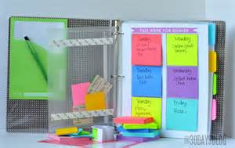
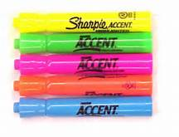
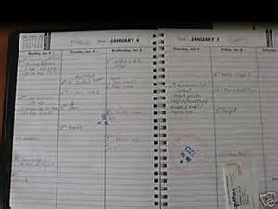

WHAT SUPPLIES DO I NEED?
Agenda
Binder or Spiral Bound Notebooks
Dividers
Sheet Protectors
Index Cards
Post – it notes
Highlighters & Sharpies
Pencils & Pens

Slide 4
How do I get started
Keep:
Syllabus
Current topic notes
List of current vocabulary
All study guides
All graded assignments for the semester
Throw out:
Used scratch paper
Old illegible notes
Duplicate copies of papers
Wadded paper
Anything not listed on the keep side

Slide 5
Think fast
http://www.online-stopwatch.com/full-screen-stopwatch/?ns=../s/3.mp3&nslen=3&countdown=00:05:00

Slide 6
Now what?
Leave a blank sheet of paper at the beginning of your notebook to use as a Table of Contents or a Quick Reference Guide
Put the remaining papers in chronological order
Number each page
Hole punch papers to put in your binder
Use sheet protectors to help maintain your notes
Do regular organization maintenance for each class

Slide 7
Organization resources online
http://www.ncld.org/students-disabilities/homework-study-skills/tips-teens-getting-organized
http://www.wikihow.com/Get-Organized-in-High-School
http://www.fennimore.k12.wi.us/hspages/tech-d/documents/OrganizationalandTimeManagementtipshand-out.pdf
http://www.sbschools.org/schools/sbhs/sps/study_tips.php

Slide 8
Learning style inventory
http://www.how-to-study.com/
http://www.educationplanner.org/
http://www.personal.psu.edu/bxb11/LSI/LSI.htm
https://www.engr.ncsu.edu/learningstyles/ilsweb.html
It’s important to know how you learn best:

Slide 9
basic study skills tips
Write down the dates of tests, quizzes, and projects in an agenda
Make a plan and work your plan: to-do lists, goals, objectives
Set a time to study
Discipline yourself to study each day
Work on the most complex activity first
Review notes each day after class
Study when you are fresh, nourished, and hydrated

Slide 10
Study skill tips for auditory learners
Using word association to remember facts and lines.
Recording lectures.
Watching videos.
Repeating facts with eyes closed.
Participating in group discussions.
Using audiotapes for language practice.
Taping notes after writing them.
http://homeworktips.about.com/od/homeworkhelp/a/auditory.htm

Slide 11
Study skill tips for visual learners
Use diagrams and concept maps with symbols for ideas and information
Use visualization techniques
Use visualization techniques
Use different color pens, highlighters, or markers to differentiate information
Rewrite notes onto flash cards for study
Type notes taken in class using bold type, different fonts, and italics
http://www.how-to-study.com/study-skills-articles/visual-learner.asp

Slide 12
Study skill tips for kinesthetic learners
Take lots of in class
Edit and type your notes later
Study in short bursts with frequent short breaks
Squeeze a stress ball or tap a pencil while you study
Use your finger as a guide when you read
Close your eyes and “write” information in the air
http://www.how-to-study.com/study-skills-articles/tactile-kinesthetic-learner.asp

Slide 13
Study Skills Resources online
http://psychcentral.com/lib/top-10-most-effective-study-habits/000599/3
http://www.memory-improvement-tips.com/best-study-skills.html
http://homeworktips.about.com/od/studymethods/a/3-Way-And-3-Day-Study-Strategy.htm
http://ideas.time.com/2013/01/09/highlighting-is-a-waste-of-time-the-best-and-worst-learning-techniques/
http://www.csc.edu/learningcenter/study/studymethods.csc

Slide 14
What do you need to start thinking about in order to be successful throughout the rest of high school and to prepare for college?
GPA
Transcript
Study skills

Slide 15

What goes into your GPA?
  Grades
  Type of classes
  Number of credits the classes are worth
  Number of classes
Notes:
Show Guidance Google Excel Spreadsheet

Slide 16
Why is your GPA important?
College applications
Internships
Scholarships ($$$$)

Slide 17
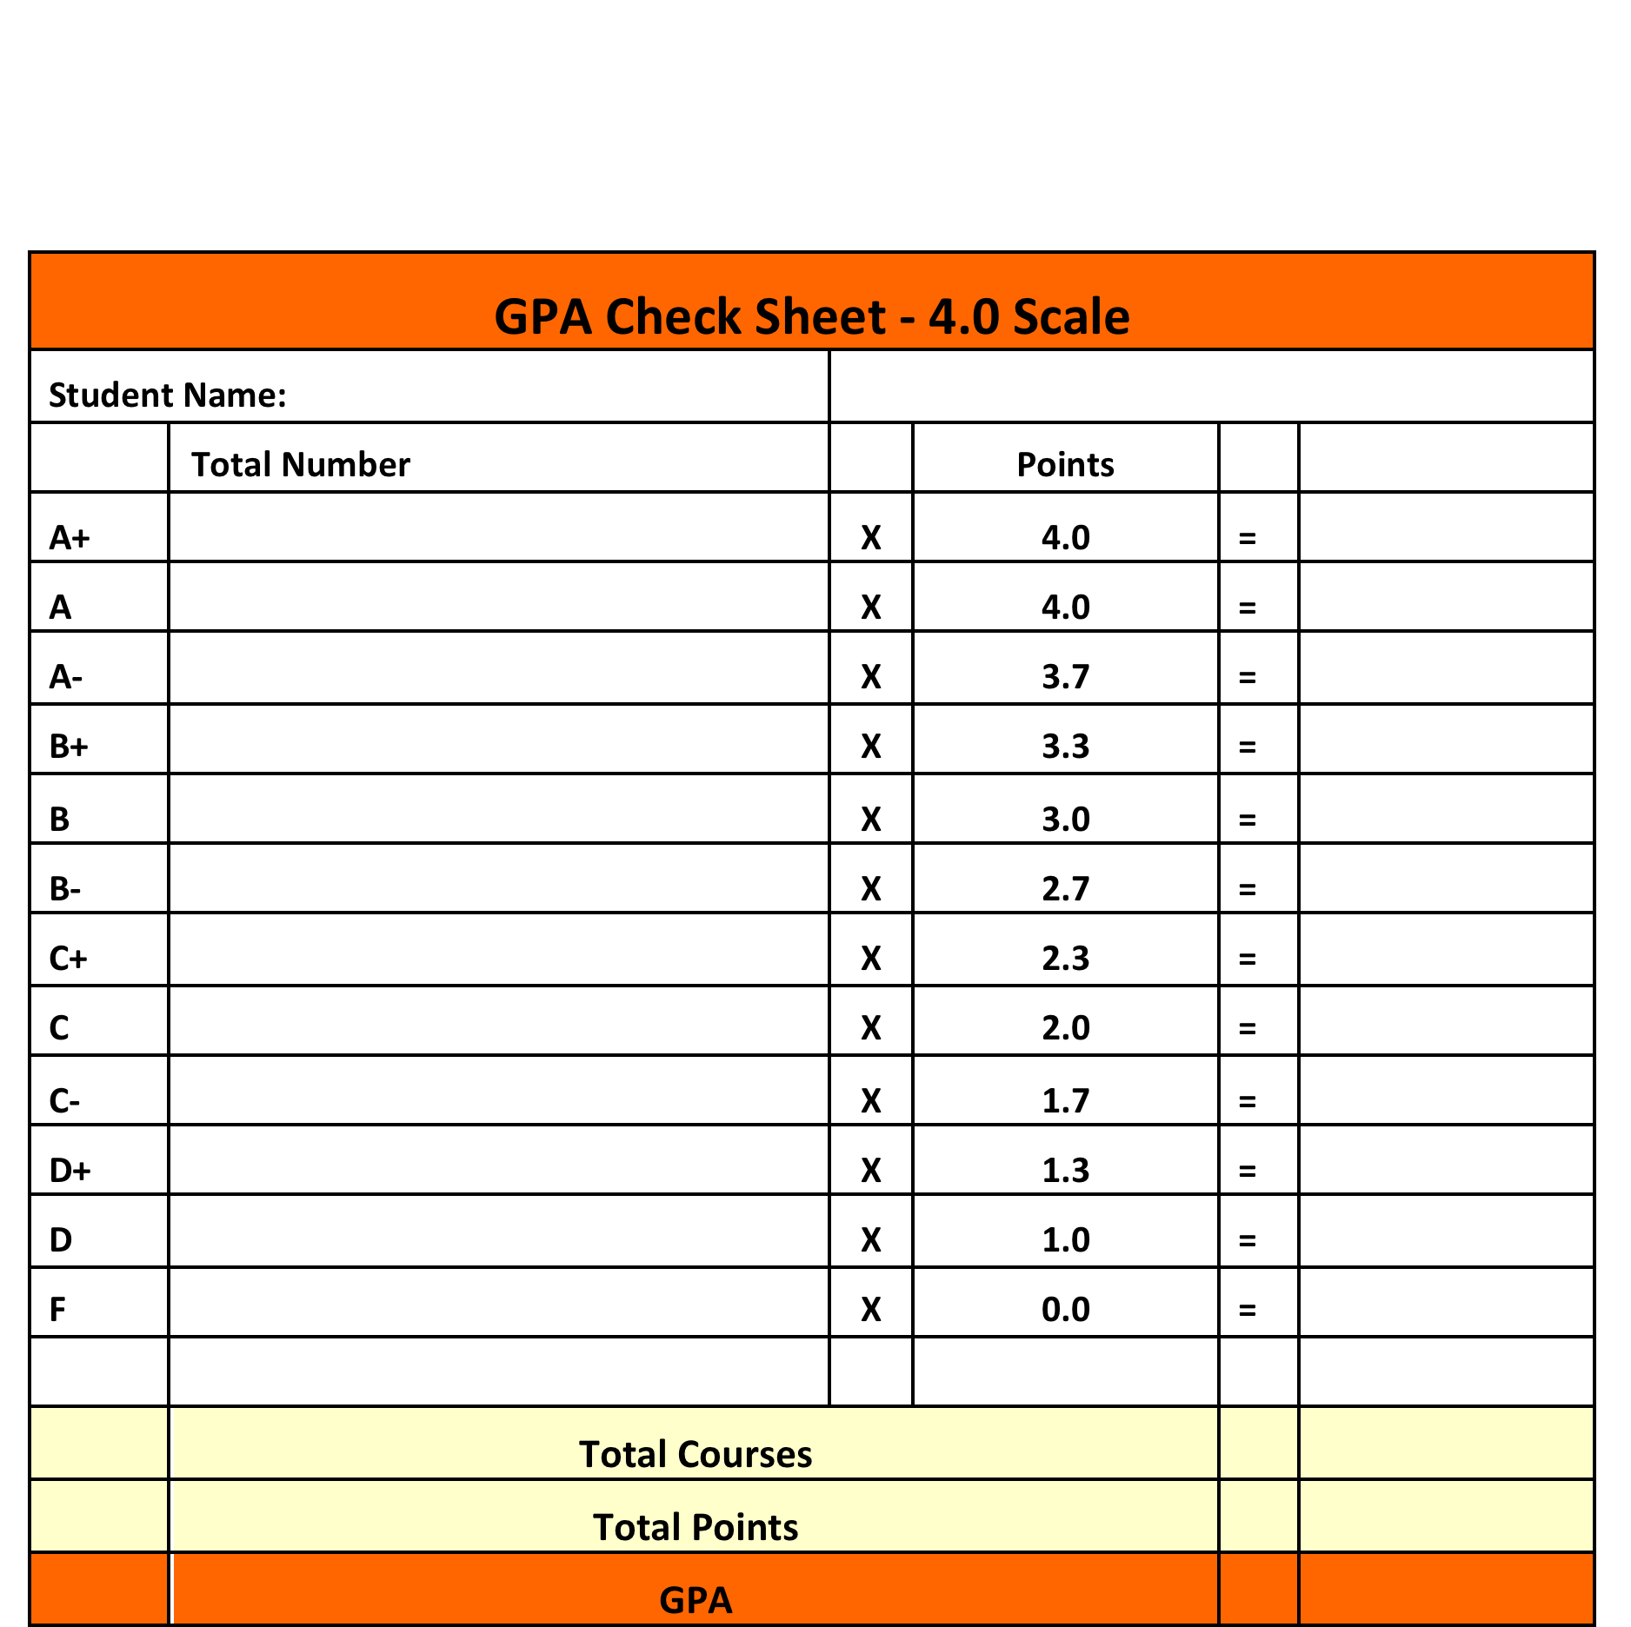
So how do I figure out my GPA?

Slide 18
What is on your transcript?
A transcript is a record of your time spent in high school– and one of the most important sources of information for colleges!
  Coursework
  Grades
  Credits
  GPA
  Test scores

Slide 19

How Can I Be Successful?
Study Skills
  Mnemonic devices
  Memory pegs
  Note cards
  Not cramming
  Graphic organizers
  Note-taking
  Keep your brain energized
  Take breaks
  Know where to get help
Notes:
Have students get in groups and come up with ideas to present to class.
Mnemonic devices: ROYGBIV
Note cards: online resources
Memory Pegs: refer to SSS

